Slide 2
#2] Spin Glasses
Experimentally driven 1972; theoretical explained beginning in 1975 onwards… Still questions today!
Last of the classical (not quantum, but temperature-driven) phase transitions into a new state of matter using novel classical statistical mechanics.
“Order”, an unusual phase transition, out of randomness, competing interactions, and frustration.
A frozen glass of spins!
Very large-scale computer simulations.

Slide 3
Spin Glasses – Redux
J. A. Mydosh
Kamerlingh Onnes Laboratory
Leiden University, The Netherlands
Introduction: What is a spin glass.
History of spin glasses.
Basic experimental properties.
Early theories and models.
Present state of spin-glass behavior.
Chiral glasses.
Quantum spin glasses.
Future

Slide 4
What is a Spin Glass
Novel, yet classical, phase transition into a new state of matter: A frozen glass of spins.
Theoretical models with solutions of the phase transition available for spin glasses.
N.B. differences from real (window) glasses – no simple model solution or theory. Everybody loves a solvable model – almost.

Slide 5
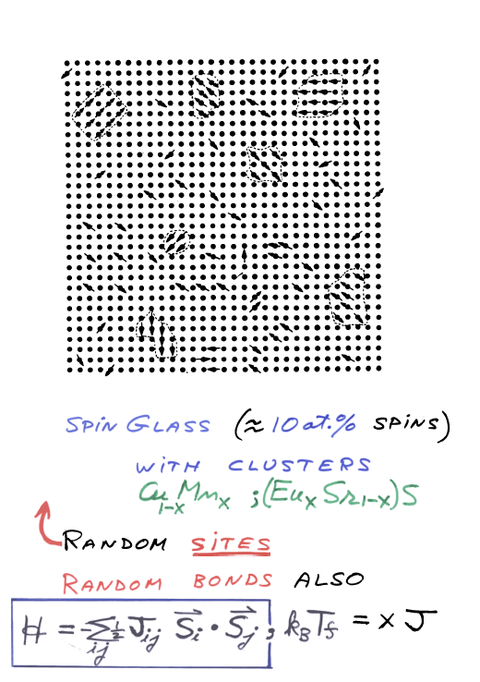

Slide 6
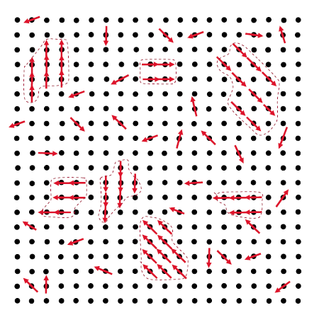
Cluster SG with ferromagnetic (mictomagnetic) regions

Slide 7
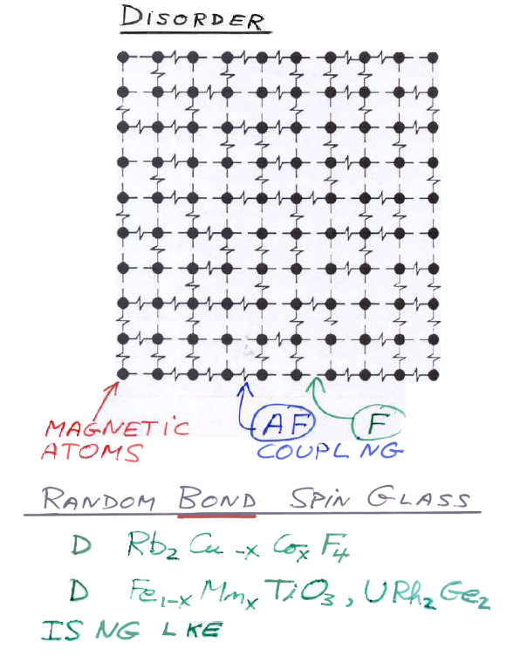
2
3
i
i

Slide 8
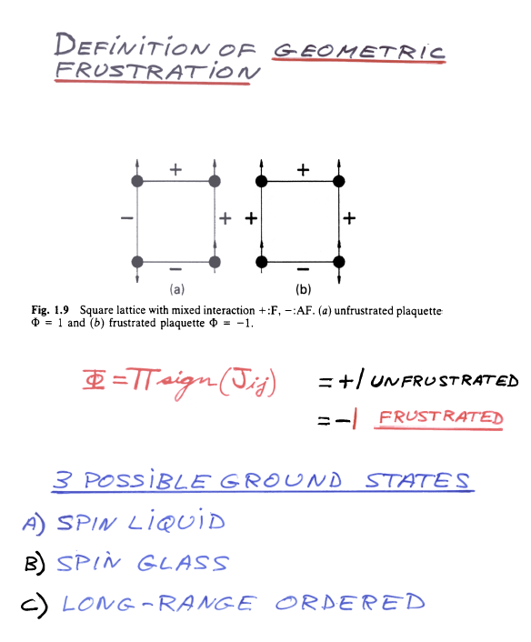

Slide 9
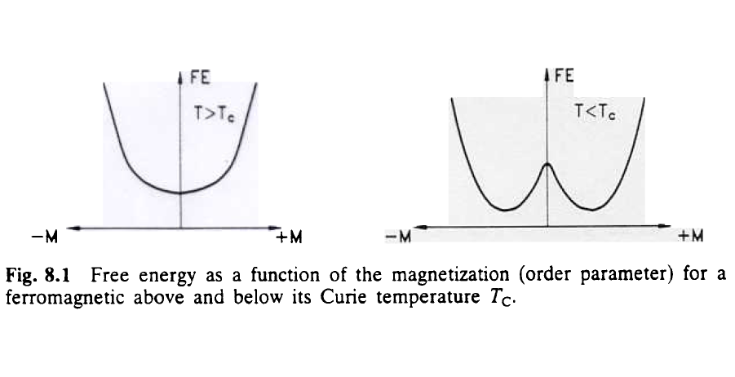
Two valley landscape of ferromagnet

Slide 10
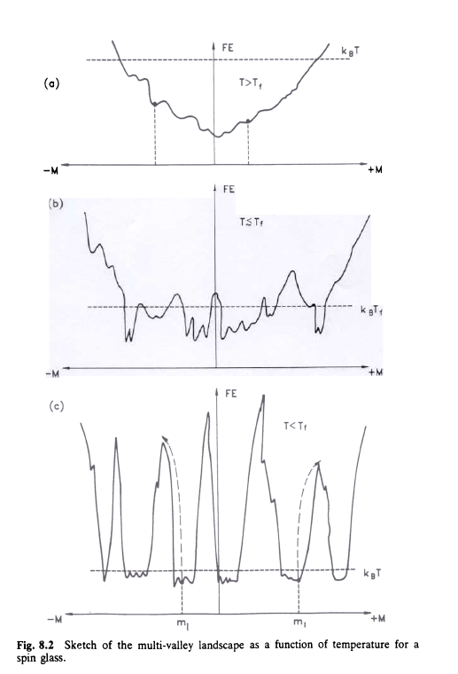
Development of multi-valley landscape
Slow dynamics
Non-equil. “aging”

Slide 11
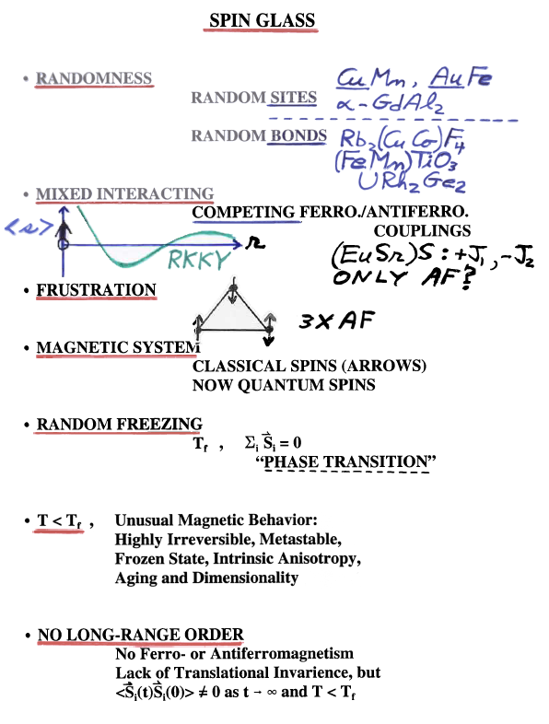
Summary →

Slide 12
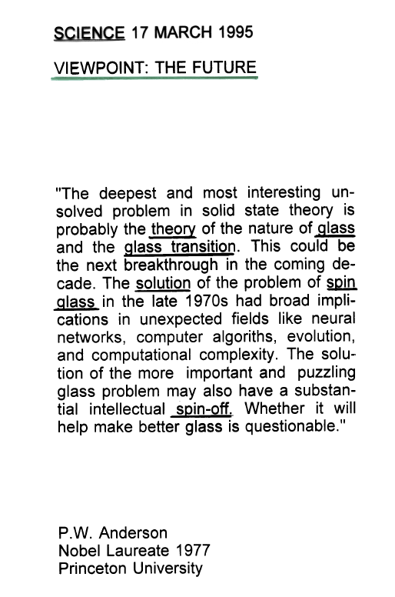

Slide 13
History of Spin Glasses
V. Cannella and JAM, Phys. Rev. B 6, 4220 (1972 ).
S.F. Edwards and P.W. Anderson, J. Phys. F 5, 965 (1975).
K. H. Fischer, Phys. Rev. Lett. 34, 1438 (1975).
D. Sherrington and S. Kirkpatrick, Phys. Rev. Lett. 35, 1792 (1975).
And then all hell broke loose! G. Parisi, Phys. Rev. Lett. 43, 1754 (1979); ibid 50, 1946(1983).
See for experiment: I.A. Campbell and D.C.M.C. Petit, J. Phys. Soc. Jpn. 79, 011006 (2010).
See for theory: H. Kawamura, J. Phys. Soc. Jpn. 79, 011007 (2010).

Slide 14
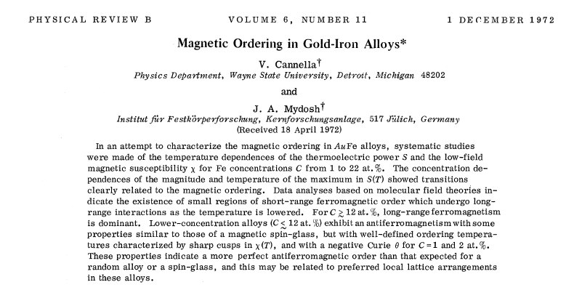

Slide 15
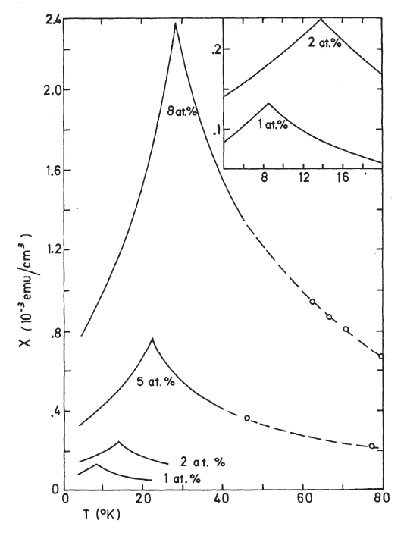
ac-linear susceptibility (h_{ac}-->0) for AuFe alloys
V. Cannella and JAM, PRB 6, 4220 (1972).

Slide 16
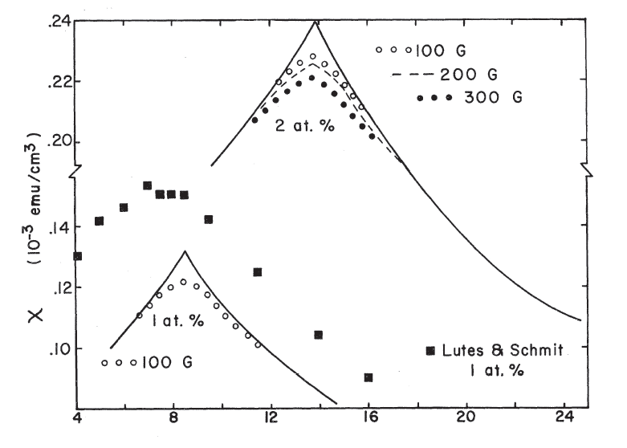
Field dependence of ac-susceptibility for AuFe
In external field of 1000 G
V. Cannella and JAM, PRB 6, 4220 (1972).

Slide 17
Evolution of Early Spin Glass Theories
E-A → KF (1975): “OP_{EA}” for ergodic system and χ_{LR} = C/T[ 1 – q(T)].
S-K (1975): q = q_{EA} a constant, RSB scheme incorrect, unstable solution for SG state.
GP (1979): Spontaneous-RSB scheme OP is q(x) is a continuous variable as RSB matrix blocks → ∞, 0 < x <1 (probability distribution of overlaps P(q) or x is time scale).
F-H (1986): Low energy excitations of droplet of reversed spins E ~JL^{y} , random changes (δJ or δT)L^{d/2}, if d/2 > y, have SG instability.

Slide 18
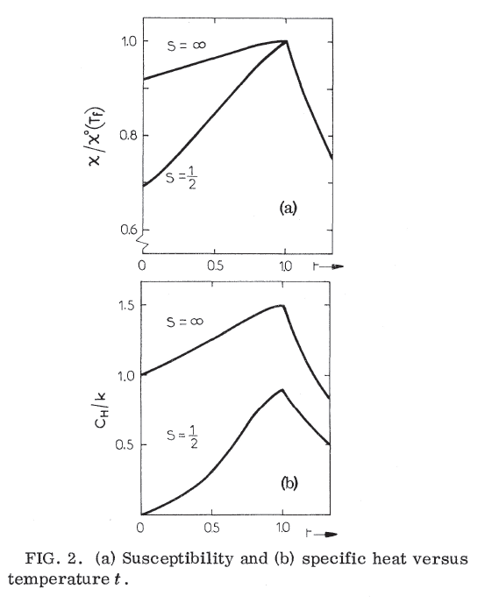
EA & SK models and Fisher calculation: Random bonds of Ising classical with spins = ½ , ∞ or +/-1. Bonds form a Gaussian probability distribution. Solution of free energy (F) via replica trick for partition function (Z) F = -k_{B}TlnZ. Results for χ and C

Slide 19
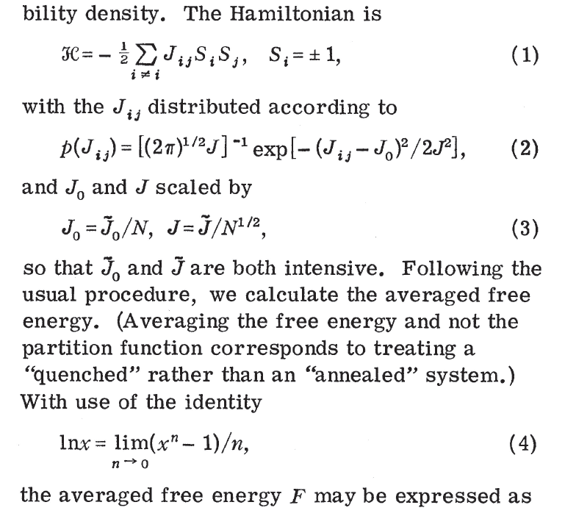
Introduction to S-K model – PRL 35, 1792(1975)

Slide 20

Early Theories and Models – Ising Spin Glasses: A difference in predictions
Replica Symmetry Breaking Model: G. Parisi, PRL 50,1946(1983). Continuous order parameter-q(x), i.e., many equilibrium states related to probability distribution of overlap of the magnetization in the different state. Predicts SG phase transition also in magnetic field.
Droplet Model: D. Fisher and D. Huse, PRB 38, 386(1988). Scaling of low-lying large-scale droplet excitations. Clusters of coherently flipped spins. Magnetic field destroys the SG phase, only a dynamical crossover.
How to tell the difference via experiment or simulation???

Slide 21
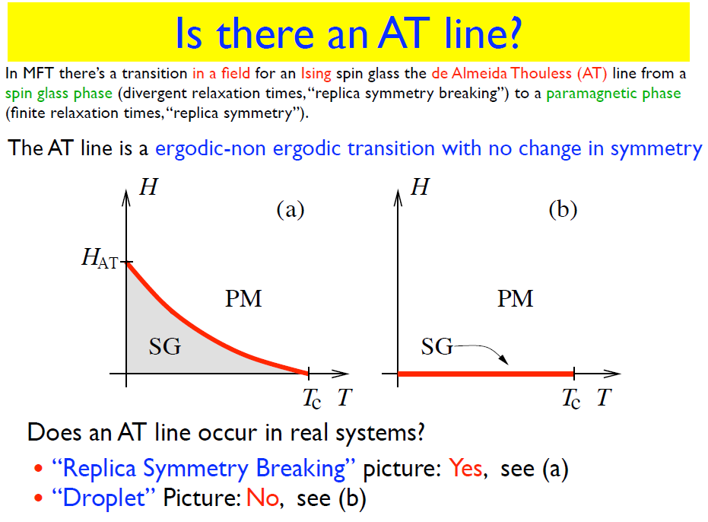

Slide 22
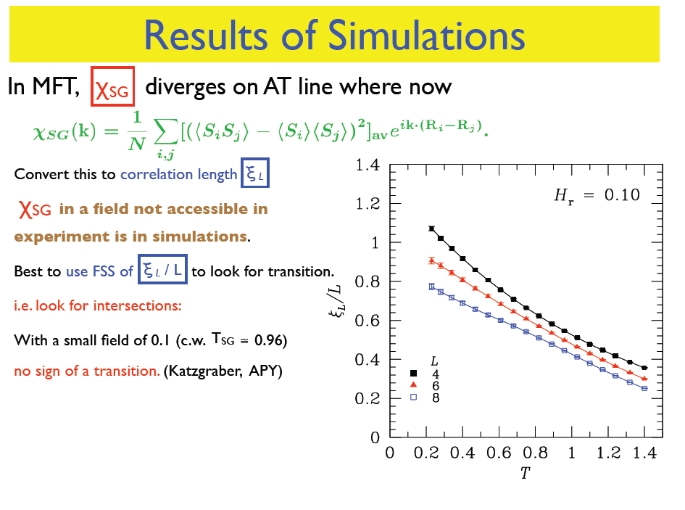
For FSS see below
No crossings
Controversy !!!
Indeed phase transition in small external fields outside of MFT. (Leuzzi, Parisi PRL (2009)). Experiment not yet found!

Slide 23
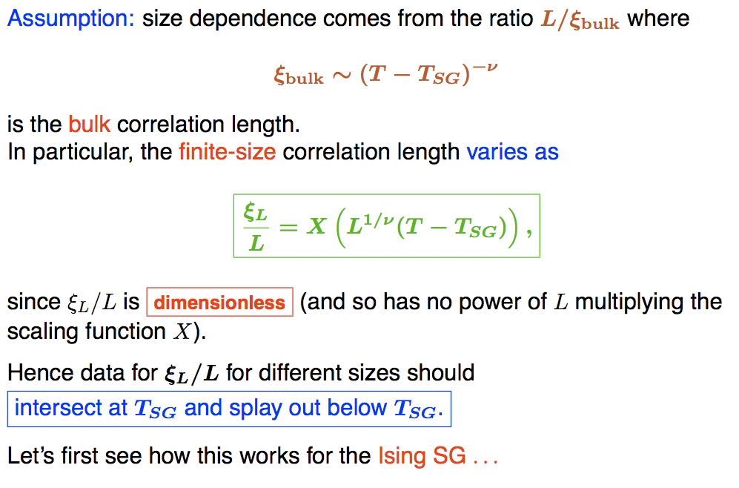
Finite size scaling: Is there a SG phase transition?

Slide 24
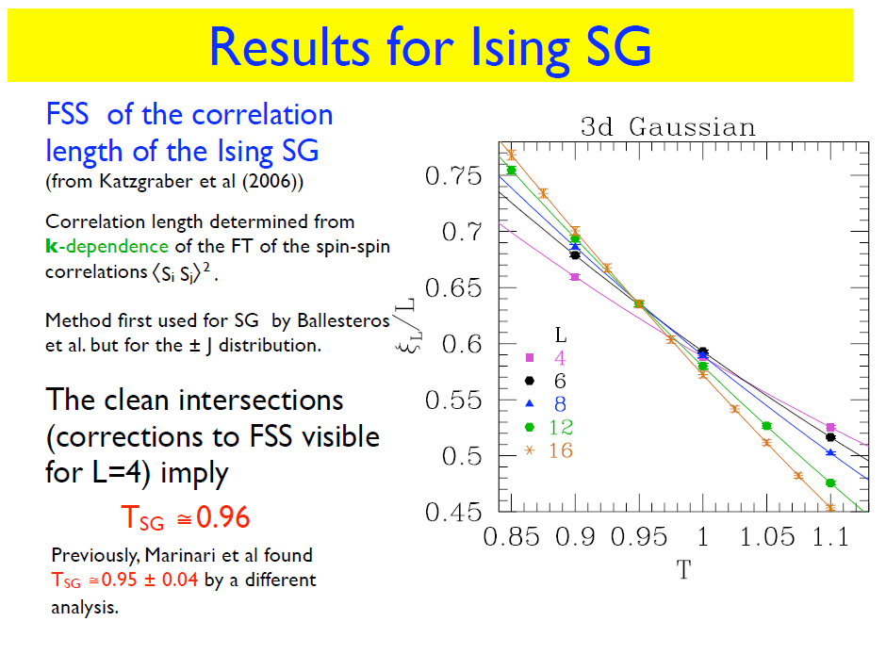
P. Young, lecture notes (2010)

Slide 25
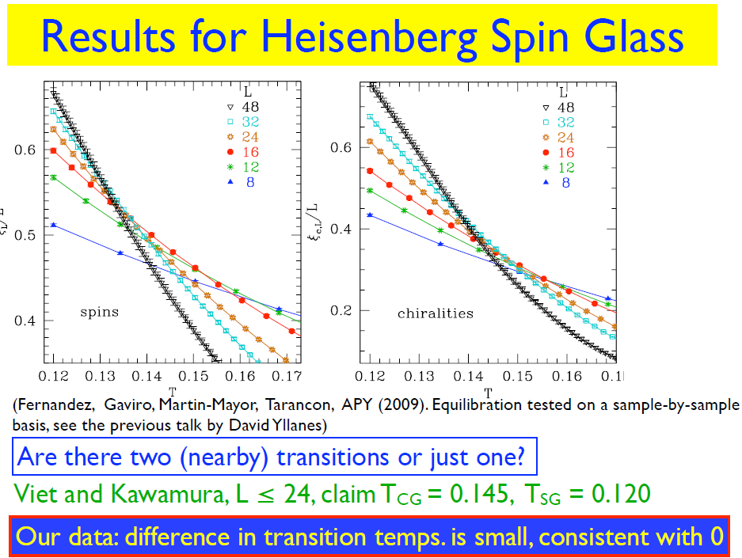
What is SG chirality? See below

Slide 26
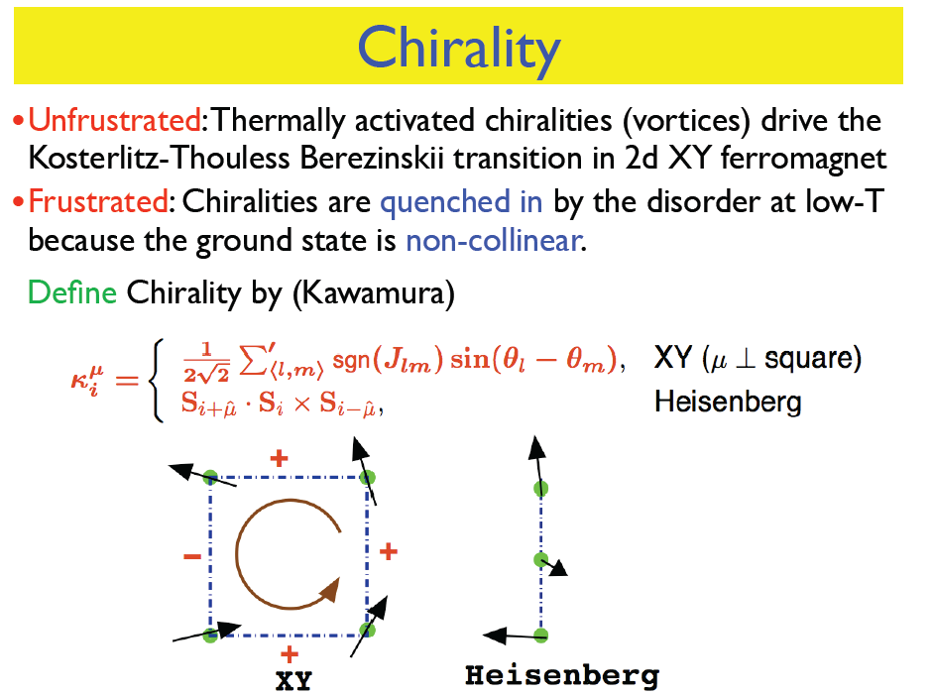

Slide 27
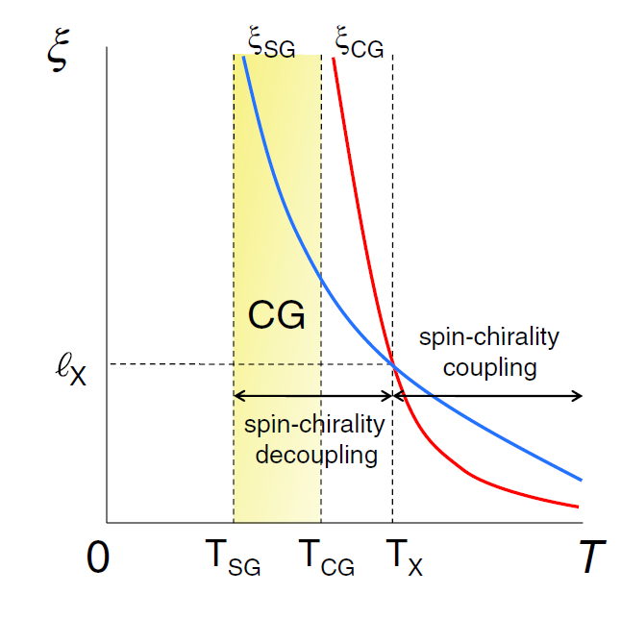
Which correlation diverges first: SG or CG ?
Is there a CG phase transition???

Slide 28
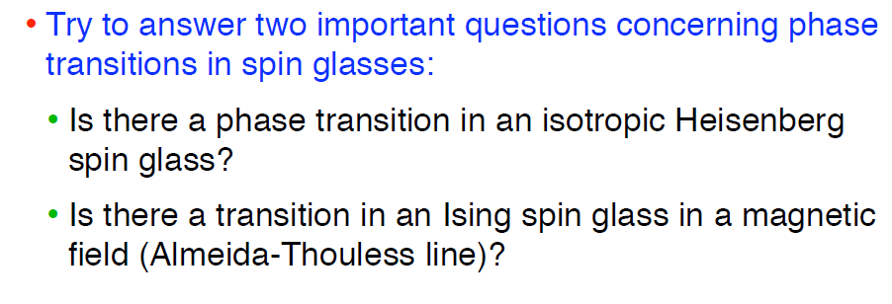
Two traditional questions, yet to be answered in 2012
What about a chiral spin glass? Need experiment?

Slide 29
Basic Experimental Properties
Four key experimental characteristics of spin glass:
Frequency dependent cusp in ac-susceptibility; divergence in non-linear susceptibility.
Difference between field cooling (FC) and zero field cooling (ZFC) magnetization.
Broad maximum in specific heat, non-critical behavior.
Metastable and aging low-temperature behavior.

Slide 30
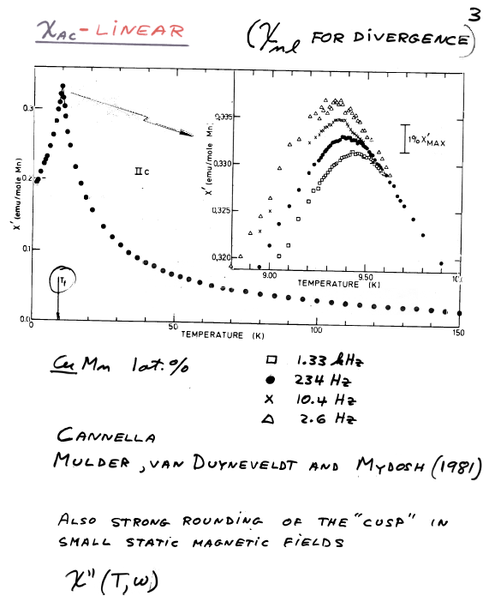
1)

Slide 31
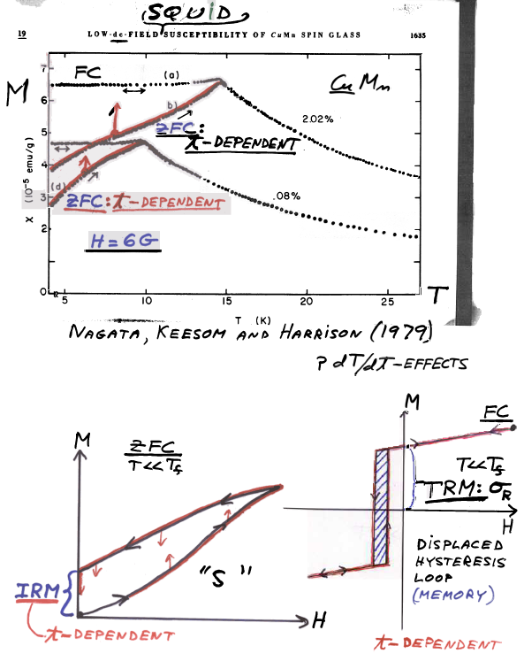
2)

Slide 32
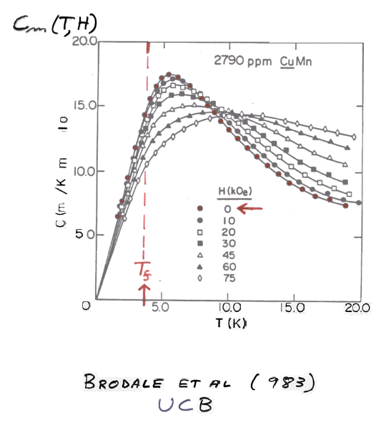
3)
1

Slide 33
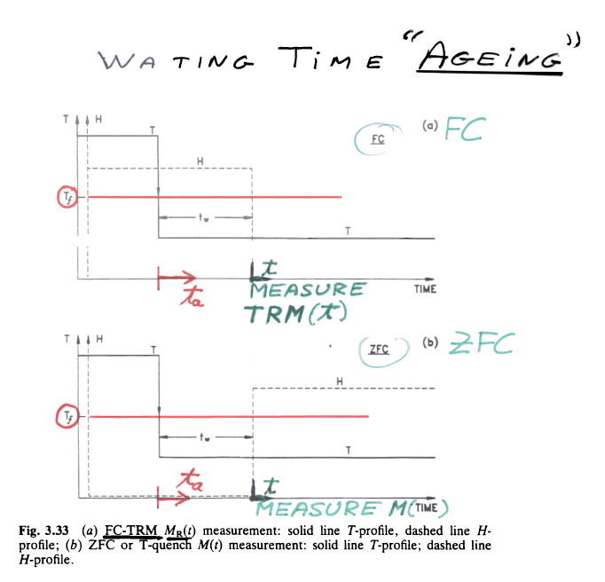
4a)
i
t_{a} = t_{w} + t

Slide 34
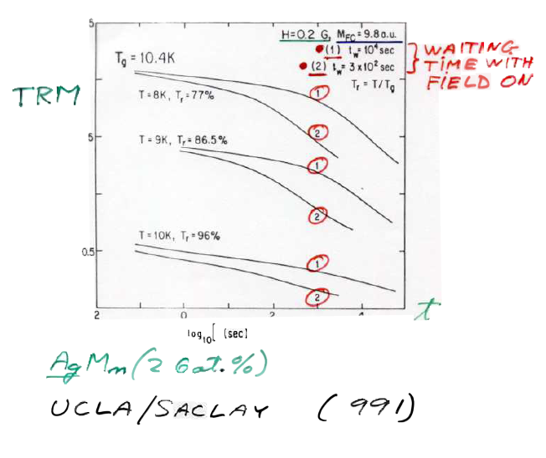
4b)
.
1

Slide 35
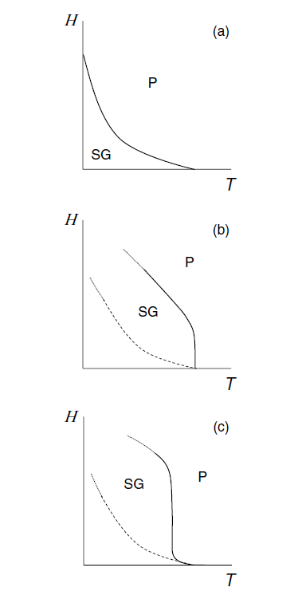
RSB predicts phase transition
Mean-field H – T phase diagram for Ising SG. (de Almeida-Thouless line)
Droplet predicts crossover, no RSB for phase transition
Present experimental and numerical simulations favor droplet model
Mean-field H – T phase diagram for isotropic Heisenberg SG (Gabay-Toulouse line)
Onset of transverse SG order
Crossover to de A -T line
Mean-field H – T phase diagram for weakly anisotropic Heisenberg SG
Experimental situation for AuFe, CuMn, AgMn, etc. SG’s
de A - T line transition to longitudinal spin order

Slide 36
Critical exponents of SG phase transition at ε = (T – T_{C})/T_{C} from susceptibility, magnetization and specific heat measurements as function of T and H in dimension d
β is order parameter exponent
γ is susceptibility exponent
α is specific-heat exponent
δ is magnetic-field exponent
η is correlation function exponent
ν is correlation exponent
ψ is free energy-barrier length-scale exponent
θ is droplet length-scale “L”
These critical exponents are related to each other by “scaling
relations”, e.g. ν = γ/(2 – η), α = 2 – dν, β = γ/(δ – 1), etc.

Slide 37
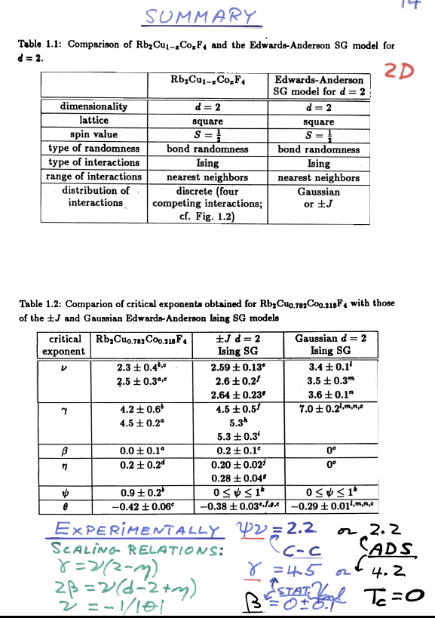
Ising SG
T_{C} = 0

Slide 38
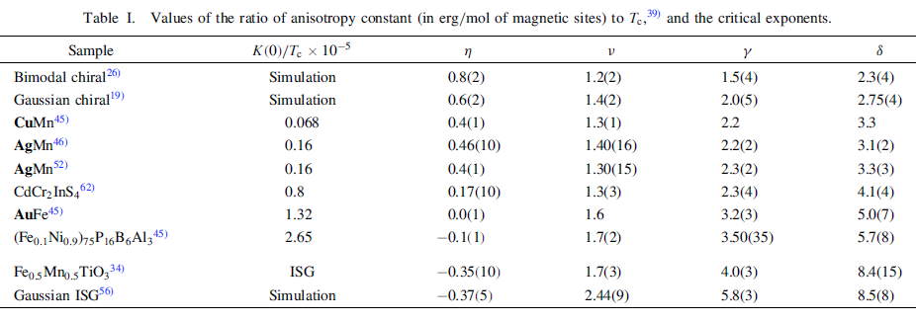
3D Heisenberg SG’s with weak anisotropy K(0)/T_{C}
Simulations [PRB 80,024422(2009)] (48³ & 10⁷CPU hr.) based upon E-A model show finite T_{C} with SG OP: q_{i}^{µν} = S_{i}^{µ(1)}S_{i}^{ν(2)} yet a new chiral OP appears with better agreement to experiment of critical exponents.

Slide 39
Chiral Glasses
Kawamura [PRL 68,3785(1992)] proposed a multispin “handyness” of the non-collinear 3D Heisenberg E-A model, i.e., the spin structure is right- or left-handed. Chirality with its associated OP.
κ_{i}^{µ} = S_{i+µ} ∙ (S_{i} x S_{i-µ})
where µ is a lattice direction unit vector of the spin
Definition of Chiral OP: q_{CG,i}^{µ} = κ_{i}^{µ(1)} κ_{i}^{µ(2)}
Competition between spin OP and Chiral OP as determined by their correlation lengths, ξ_{SG} and ξ_{CG}.

Slide 40
Present State in 2010 of Spin-Glass Behavior
Controversy – numerical simulations of 3D Heisenberg SG bigger and longer.
Little new experiment on canonical SG’s.
SG behavior found in many new systems, e.g., disordered magnetic nanostructure materials.
Interest in chiral and quantum SG’s but mainly from theoretical point of view.

Slide 41
Quantum Spin Glasses
What is a quantum SG
Theory can calculate but experiment is lacking
Is there a good quantum SG in nature?
Disappointment with LiHo_{x}Y_{1-x}F₄

Slide 42
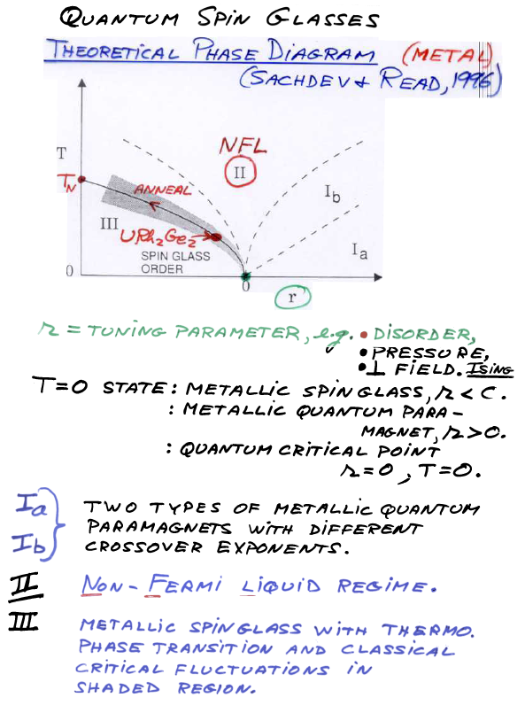

Slide 43
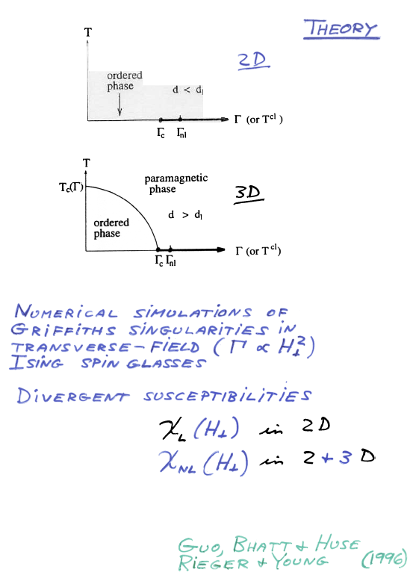

Slide 44
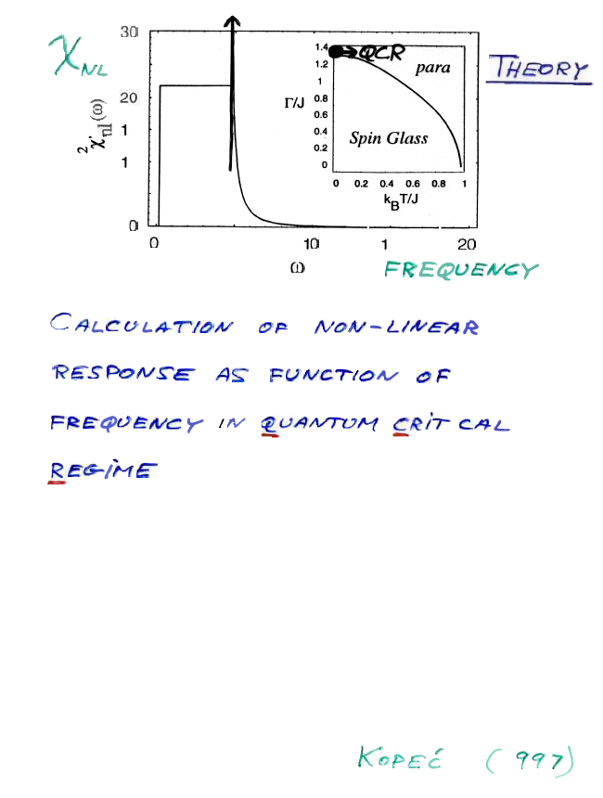
1

Slide 45
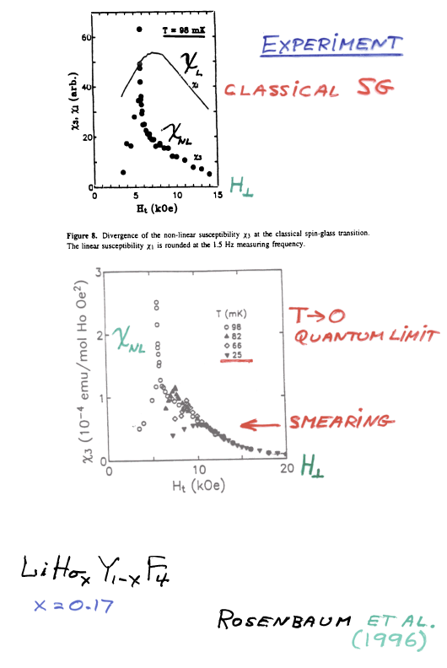
Not a canonical SG, see PRL105,107203(2010)!!!

Slide 46
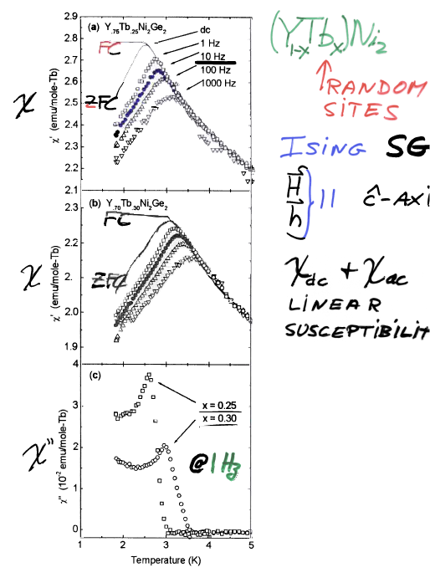
Ge₂
s
Canfield et al., PRB(2000).

Slide 47
Future
Need new experiments, yet very time and energy consuming.
Ongoing simulations on larger and larger parallel processing computers.
Need final proof of line dA-T.
Need final proof of chiral spin glass.
Experimental search for a quantum spin glass has not yet been rewarded.
Nanostructured spin glasses – size effects.

Slide 48
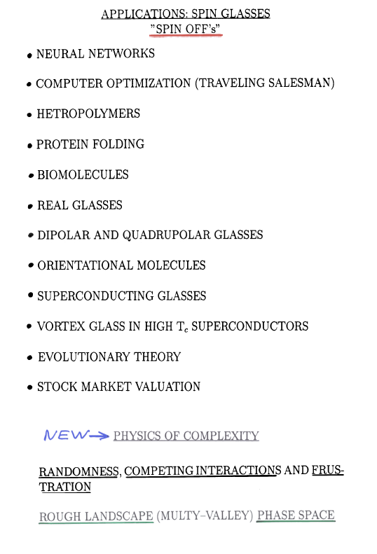

Slide 49
OPEN TO BE USED

Slide 50
To be used

Slide 51
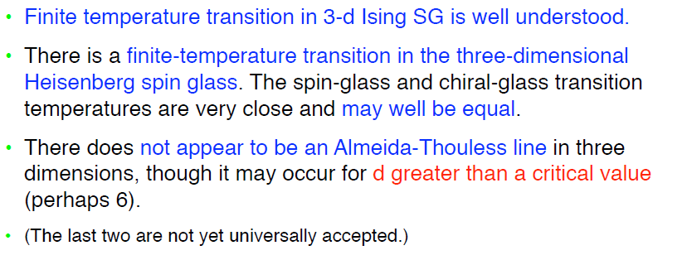
Some conclusions (PY)

